Slide 1
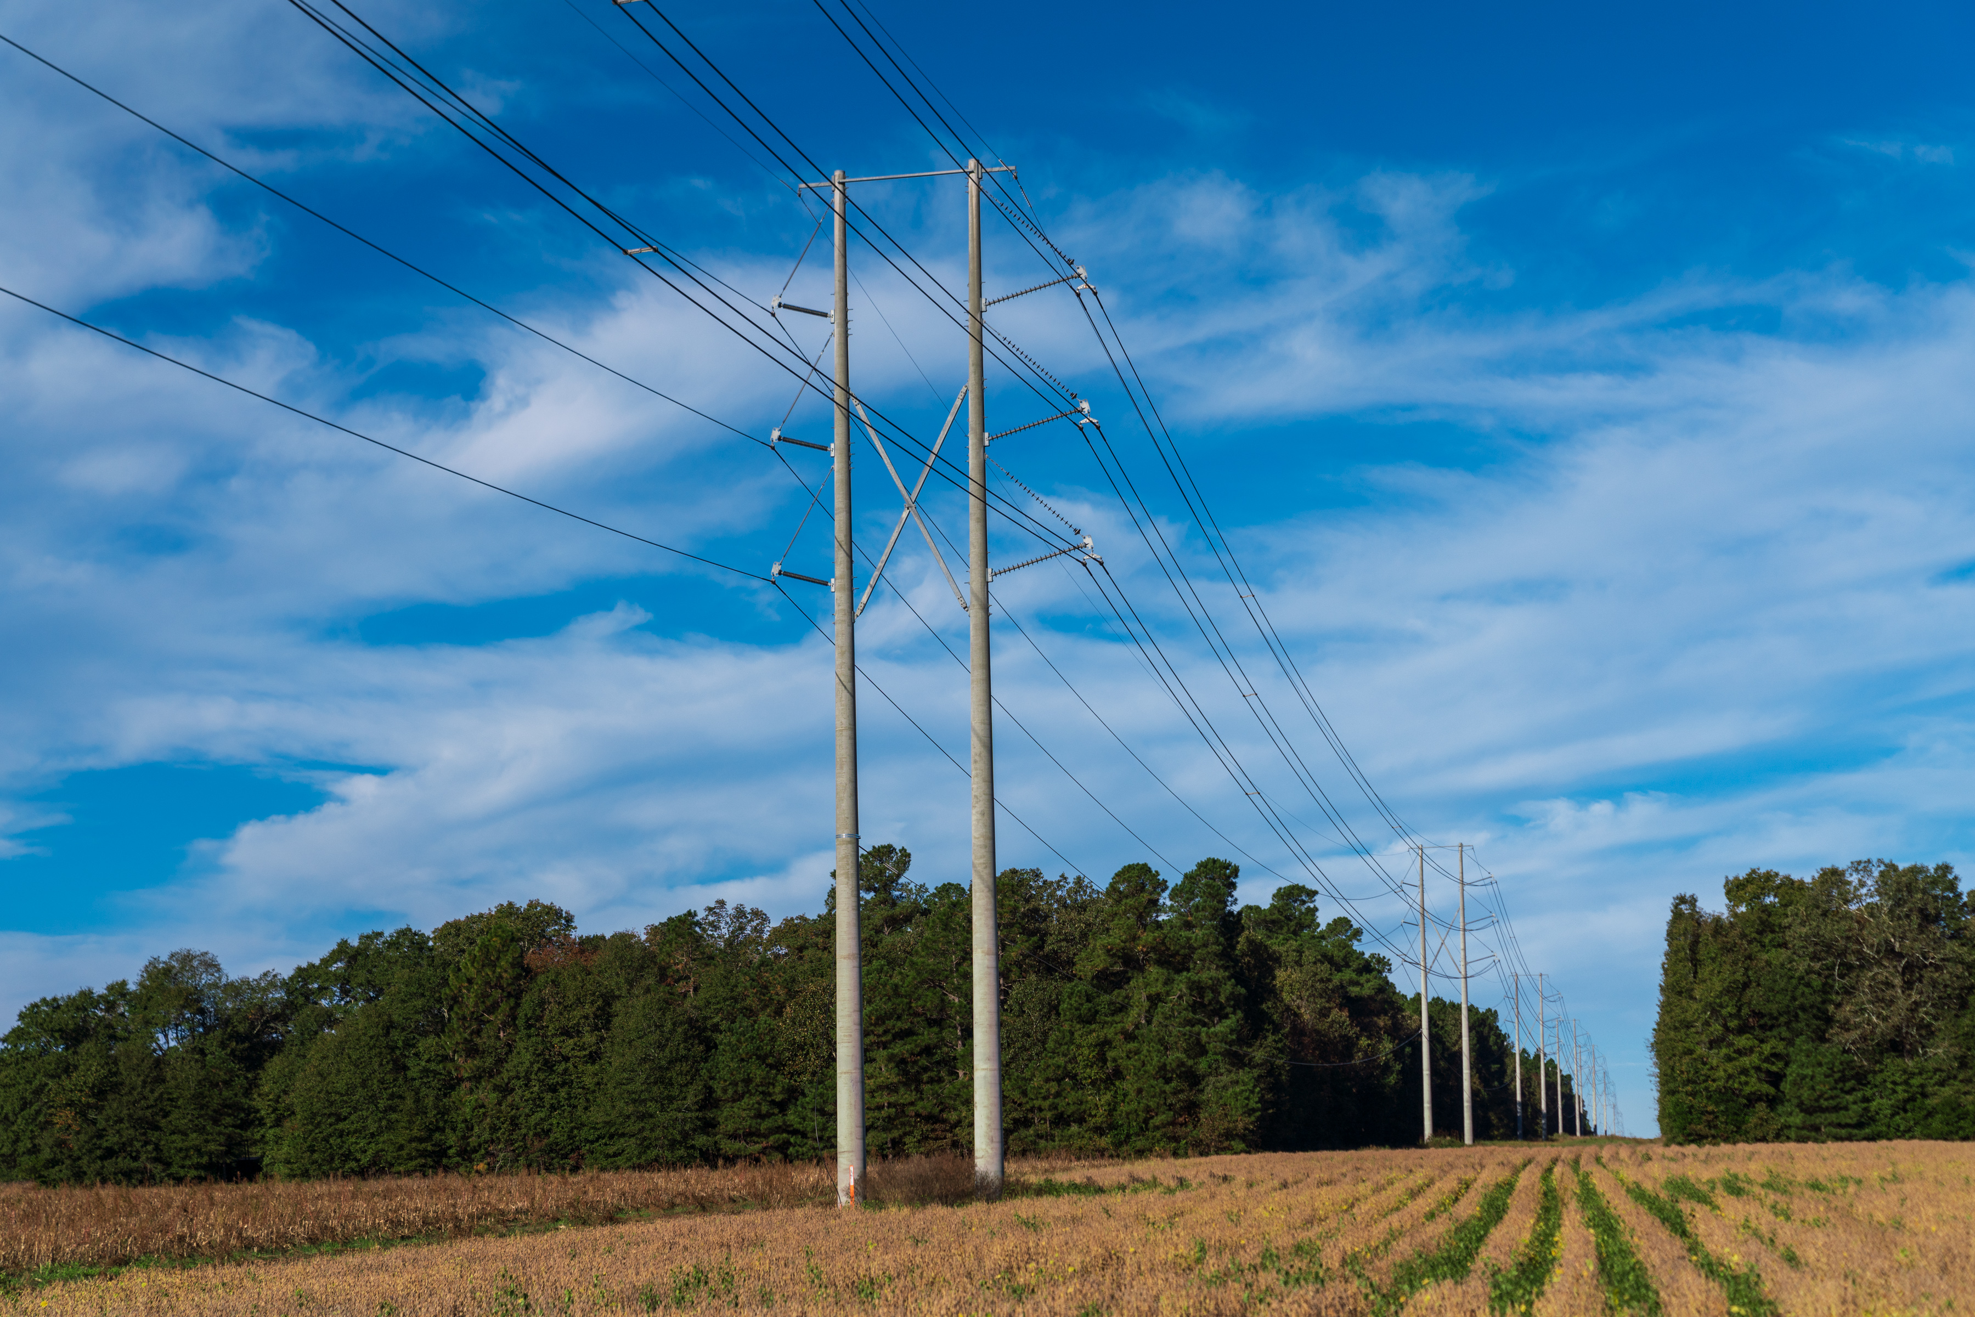
Proposed South Carolina Grid Resilience Grant Program
BIL 40101(d) Formula Grant
Public Hearing | November 7, 2022

Slide 2
TODAY is about…
Sharing our proposed approach for South Carolina’s Application for Bipartisan Infrastructure Law 40101(d) Formula Grant
Getting your input to the proposed objectives, criteria, and metrics
Proposed GRG Program, BIL 40101(d)

Slide 3
Agenda
Introductions
Bipartisan Infrastructure Law 40101(d) Overview
Proposed Grid Resilience Grant Program
Strategic Approach
Implementation
Open Floor
Next Steps
Infrastructure Investment and Jobs Act (IIJA), Pub. L. No. 117-58 (Nov. 15, 2021), Sec. 40101(d) (codified at 42 U.S.C. 18711(d)), available at https://www.congress.gov/bill/117th-congress/house-bill/3684/text.

Slide 4
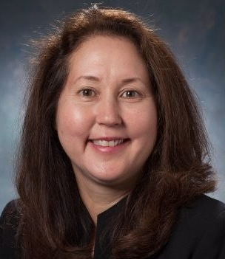
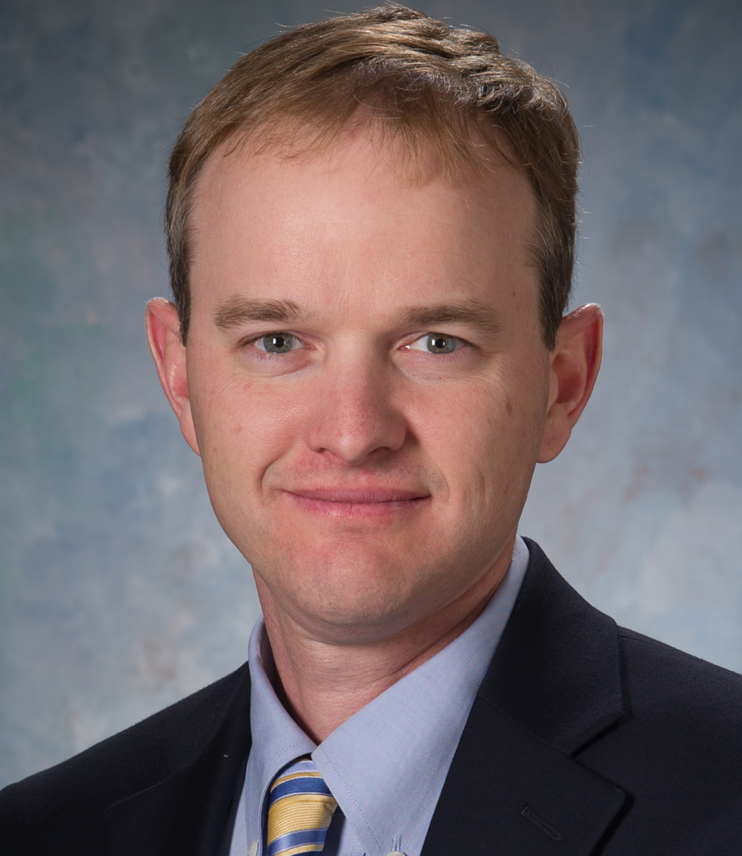
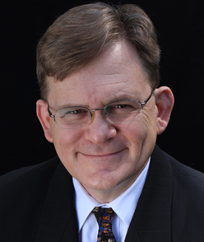
Presenting
Vicky Budreau
Sr. Director, Wholesale & Industrial Customer Service
Greg Edwards
Associate General Counsel
Chris Wagner
Director, Transmission Planning, Research & Development
Stewart Ramsay
Facilitator
Vanry Associates
Proposed GRG Program, BIL 40101(d)

Slide 5
Guidance for participation
Meeting video, audio and written comments/questions will be recorded and shared publicly following the meeting
Zoom Platform Functionality - why this format?
Use the Q&A for comments or questions during the presentation – we have a team of people to answer your questions
We will open the floor throughout the meeting – use the Raise Hand if you would like the chance to speak, we will unmute you and welcome you to turn on your video if you are able and inclined to do so
Throughout we will use the Polling feature to get your feedback on some questions we have
We will ask for your final thoughts and meeting input in an Exit Survey
Proposed GRG Program, BIL 40101(d)

Slide 6
Bipartisan infrastructure law OVERVIEW
IIJA Section 40101(d)

Slide 7
Grid Resilience
Significant value in having customers more resilient to severe weather events
Safety
Continued provisions of essential services (electricity, water, sewer)
Access to food, fuel
Access to medical facilities
Economic
Reduced damage to property
Reduced risk of lost income
Mitigation to increases in costs of essential services & insurance
Federal and State Governments focused on making the grid more resilient
Bipartisan Infrastructure Law provides $5 Billion for electric grid resiliency
Approximately 50% of that for States, Territories, and Tribes to harden the grid nationwide
Notes:
The Preventing Outages and Enhancing the Resilience of the Electric Grid Grants are designed to make grants to eligible entities, States, and Tribes to prevent outages and enhance the resilience of the electric grid.

Slide 8
Grid Resilience Initiative
Formula Grants Summary
States, Territories, & Tribes
$2.3B allocated for 40101(d) (approx. $459M/year, FY 2022-2026)
Year 1, at least $5.2M for South Carolina
15% match by Santee Cooper on behalf
of South Carolina
Up to 5% for Technical Assistance
Legislation set five-part formula
based on population, area, probability of disruptive events, severity of disruptive events & expenditure on mitigation efforts
States, Territories & Tribes need to submit to DOE for approval
May grant subawards to eligible entities for projects
BIL : DOE GOALS
Improve energy resilience to all hazards in U.S. & mitigate climate-related risk
Invest in modernized grid infrastructure & extend customer access to lower-cost energy
Invest in clean energy and decarbonization (2035/2050)
Create good-paying jobs with free & fair choice to join a represented workforce
Proposed GRG Program, BIL 40101(d)
Notes:
Federal - $5,212,483
SC 15% match – $781,872
Total - $5,994,355

Slide 9
40101(d) Program Narrative Guidance
Improve resilience of the electric grid against disruptive events*
SUB-GRANTS MAY SUPPORT A WIDE RANGE OF INVESTMENTS
weatherization technologies & equipment fire-resistant technologies & fire prevention systems monitoring & control technologies undergrounding of electrical equipment utility pole management relocation of power lines or reconductoring of power lines with low-sag, advanced conductors vegetation & fuel-load management use or construction of distributed energy resources for enhancing system adaptive capacity during disruptive events microgrids, & battery-storage subcomponents adaptive protection technologies advanced modeling technologies hardening of power lines, facilities, substations & other systems replacement of old overhead conductors & underground cables
INELIGIBLE PROJECT TYPES
Construction of new generating facility or large-scale battery-storage facility
Cybersecurity
LIMITATION
Amount to be no greater than the total amount spent three years prior on efforts to reduce the likelihood and consequences of disruptive events
*Per BIL section 40101(a)(1),14
a disruptive event is “an event in which operations of the electric grid are disrupted, preventively shut off, or cannot operate safely due to extreme weather, wildfire, or a natural disaster.”
Proposed GRG Program, BIL 40101(d)

Slide 10
40101(d) Program Narrative Guidance
Eligible entities for subawards
Electric grid operators
Electricity storage operators
Electricity generator
Transmission owners or operators
Distribution providers
Fuel suppliers
Other relevant entities as determined by the Secretary
An eligible entity that receives a subaward under this program is required to match 100% of subaward amount.
For a small entity (not more than 4,000,000 MWh sales per year), the required match will be one-third of the subaward amount.
Proposed GRG Program, BIL 40101(d)

Slide 11
Strategic approach
Proposed Grid Resilience Grant Program 40101(d)

Slide 12
BIPARTISAN INFRASTRUCTURE LAW
GRID RESILIENCE FEDERAL ADMINISTRATION
APPROVALS
Resilience
Modernized Grid
Clean Energy
Good Paying Jobs
Equity & Justice
Community Impact
PROGRAM NARRATIVE
Objectives
& Criteria Development
Public Hearing
& Written Input
PROGRAM NARRATIVE
Project Submissions
Governance, Operational Oversight & Implementation
Metrics & Reporting
Stakeholder Input
Policy
Initiatives (future years)
SUBAWARDS
RFPs
Grid Resilience Projects Executed
LEGEND
BIL : DOE / NETL
Bipartisan Infrastructure Law – Administered by Dept of Energy & National Energy Technology Laboratory
SANTEE COOPER
Grid Resilience Grant Program – Administered by Santee Cooper on behalf of the South Carolina
ELIGIBLE ENTITIES
Grid Resilience Subaward Project(s) – Eligible entities who have proposed & received subawards
POLICY ENTITIES
State & Other Bodies with interests and initiatives related to Grid Resilience
STAKEHOLDERS
Eligible Entities and all other Interested Parties
Current State – Year one GRG Program launch and submission underway
Proposed GRG Program, BIL 40101(d)

Slide 13
Proposed GRG Program Objectives
Make meaningful progress in one or more of the following
Demonstrate measurable improvements in energy resilience for the South Carolina grid & mitigate climate-related risk
Invest in modernized grid infrastructure that enables consumer access to lower-cost energy and increased electrification increased variable renewable electricity and distributed energy sources other evolving system needs
Invest in clean energy & decarbonatization solutions → 2035 100% clean electricity → 2050 net-zero greenhouse gas emissions
Create good-paying jobs free and fair choice to be part of a represented workforce as specified in BIL
Adhere to & further the principles of equity & justice
Show a clear, positive impact on underserved communities or disadvantaged populations
BIL : DOE GOALS
FEDERAL ADMINISTRATION GOALS
Proposed GRG Program, BIL 40101(d)

Slide 14
Proposed GRG Project Objectives
Objective #1 – Increased Monitoring & Control Capabilities
DRAFT METRICS
Increased number of:
Monitored facilities
Facilities under centralized control
Automated line miles
Customers benefiting from increased automation -- broken out by customers in disadvantaged/ underserved communities
Improved situational awareness / visualization for operators
PROPOSED OBJECTIVE STATEMENT
Increased monitoring and control capabilities to provide visualization and enhance situational awareness leading up to, during, and post-extreme weather events
ANTICIPATED PROJECT TYPES
Installations such as
Expansion of Distribution Automation or Distribution Management Systems
Equipment for remote facility operation
Line monitoring equipment
Remote controlled sectionalizing devices
Proposed GRG Program, BIL 40101(d)
Notes:
POLL QUESTION

Slide 15
Proposed GRG Project Objectives
Objective #2 – Harden or Adapt Electric System
DRAFT METRICS
Avoiding or reducing consequences to:
Key electric infrastructure – reductions in outage events & permanent facility damage
Disadvantaged communities – expected reductions in SAIDI & CAIDI
Priority customers – reduction in # / duration of outages, impacts, emphasis on disadvantaged communities
Key geographic areas – avoiding wage loss & production due to disruptions
Reduction in average electric infrastructure age
Increase in % of underground line miles vs total
Reduction in # of radial line miles
PROPOSED OBJECTIVE STATEMENT
Harden or adapt the electric system to increase resiliency during extreme weather events
ANTICIPATED PROJECT TYPES
Overhead to underground conversion
Upgrades of overhead facilities, such as lines and substations
Construction of redundant paths
Proposed GRG Program, BIL 40101(d)
Notes:
POLL QUESTION

Slide 16
Proposed GRG Project Objectives
Objective #3 – Enhance Vegetation / Minimize Risk
DRAFT METRICS
Refined & optimized vegetation management
# miles cleared / # danger trees removed
Reduction in # exposed miles / customers
Reductions in # of predicted vegetation-related outages during extreme weather events
PROPOSED OBJECTIVE STATEMENT
Enhance vegetation management programs to reduce exposure to tree-related damage to the electric system during extreme weather events or wildfires
ANTICIPATED PROJECT TYPES
Advanced technology(ies) to improve vegetation practices (AI, satellite analytics, modeling)
Reclassification & removal of danger trees
Analytics-based adjustments to tree trimming activities to reduce vegetation risks
Reconfiguration or relocation of lines
Proposed GRG Program, BIL 40101(d)
Notes:
POLL QUESTION

Slide 17
Proposed GRG Project Objectives
Objective #4 – Develop Energy Storage or Microgrids
DRAFT METRICS
Number of
MWh of resilient energy supply
Resilient customers due to installation
Residents benefitting from resilient public facilities – hospitals, fire, police, shelters
More resilient community / essential locations – community centers, long-term care facilities
Underserved residents benefitting from resilient supply
PROPOSED OBJECTIVE STATEMENT
Develop energy storage & microgrids to provide system adaptive capacity to increase resilience for communities and customers – e.g., systems able to provide electrical energy during disruptions
ANTICIPATED PROJECT TYPES
Development of a microgrid(s)
Installation of battery storage at substations to serve load
Installation of distributed battery storage at critical facilities or customer locations to power the site
Proposed GRG Program, BIL 40101(d)
Notes:
POLL QUESTION

Slide 18
Thoughts & Questions?
Proposed GRG Program, BIL 40101(d)

Slide 19
implementation
Proposed Grid Resilience Grant Program 40101(d)

Slide 20
Proposed Program Criteria
Greatest community benefit
Small Utility Set Aside – 35.7% of total funding
State focused projects
Prioritize projects that deliver the greatest impact per dollar
Proposed GRG Program, BIL 40101(d)
Notes:
Federal - $5,212,483
SC 15% match – $781,872
Total - $5,994,355
Small Utility Set Aside –about $2.1M

Slide 21
Proposed Program Methods
Dedicated Program & project management
Utilize the 5% allowed for administration & technical assistance
Create set of sustainable, repeatable & adaptive processes
Provide arms-length governance, recognizing Santee Cooper may be an applicant
Goal is to maximize the value each year to the State
Proposed GRG Program, BIL 40101(d)
Notes:
5% of federal funding = about $260k

Slide 22
Phase One – Planning & Preparation
TASK 1.0
PROGRAM MANAGEMENT & ADMINISTRATION
TASK 2.0
TECHNICAL ASSISTANCE & PLANNING
TASK 3.0
RESILIENCE PROJECT APPROVALS
Establish Program management team, office & governance framework
Submit Program Narrative & SOPO
Assure Program & grant projects conform to all aspects in the execution
Prepare & submit Project Packages
Review Proposed Subawards with DOE
Upon approval, make subawards
Includes: defining roles & responsibilities, overall schedule, RFP elements, as well as receiving and evaluating proposals and community support
Proposed GRG Program, BIL 40101(d)

Slide 23
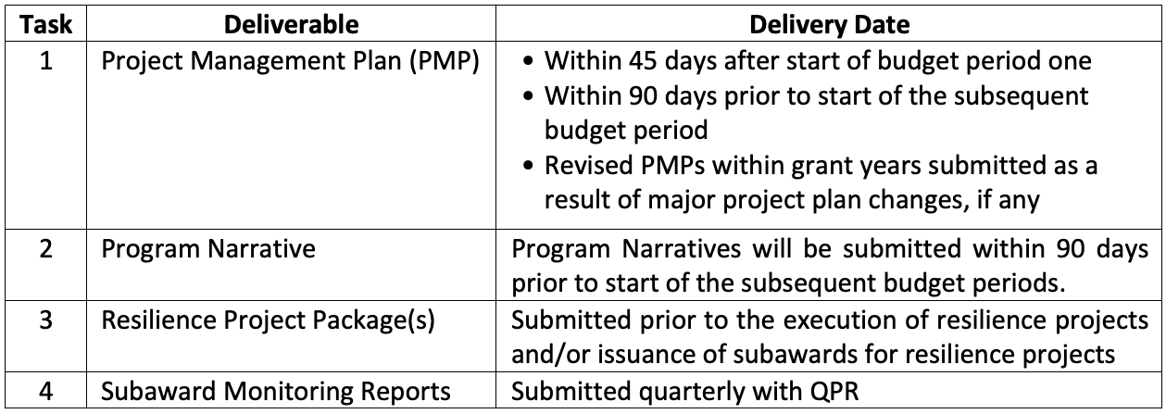
Phase Two – Implementation
RESILIENCE PROJECT EXECUTION
Upon DOE’s written determination – issue subawards to eligible entities to execute projects per 2CFR200, for each project
Monitor performance against Terms & Conditions
Ensure evidence of measurable progress
Verify extent to which established objectives are being realized
DOE Reporting
Briefings & Technical Presentations
TASK 4.0
Proposed GRG Program, BIL 40101(d)
Notes:
s

Slide 24
Open floor
Proposed Grid Resilience Grant Program 40101(d)

Slide 25
In closing, what’s next…
Consider & incorporate today’s input
Accepting written input until November 14, 2022 Send to email: gridresiliencegrant@santeecooper.com
Meeting summary, recording and Q&A reports to be posted at SanteeCooper.com/GridResilienceGrant
Santee Cooper to update & finalize application
Target date to submit application: November 30, 2022
Watch for progress updates at SanteeCooper.com/GridResilienceGrant
Proposed GRG Program, BIL 40101(d)

Slide 26
Thank you!
We have a few more questions and would appreciate some feedback on the meeting.
Please complete our survey
that will appear in your browser as you leave the meeting
Proposed GRG Program, BIL 40101(d)

